Slide 1
Waste Bin Level Prediction using Machine learning
Student Details: PRAVEEN KUMAR – 2062254
ADHIL – 2062201
Guided By: Dr . SAMIKSHA SHUKLA

Slide 2
Agenda:
Abstract
Problem Statement and Objectives
Literature Review
Research Gap
Hardware and Software Requirements
Steps to Implementation and Results
Timeline
References

Slide 3
Abstract:
The inefficient management of waste bins, resulting in overflowing containers, poses a critical challenge leading to sanitation issues and public health risks. This project addresses this problem by leveraging machine learning techniques to predict waste bin levels
The proposed model utilizes a dataset comprising historical data and real-time sensor readings to train and develop an accurate predictive algorithm
The Model's Performance is evaluated using MSE and RMSE .By forecasting the fill levels of waste bins, municipalities and waste management authorities can proactively address potential overflow situations, thereby mitigating sanitation concerns and reducing public health risks.

Slide 4
Problem Statement and Objectives:
To Develop a machine learning model to predict the fill level of waste bins based on historical data.
To Implement a machine learning algorithm to optimize waste collection routes by considering predicted fill levels of multiple bins.
To Evaluate and Optimize The Models

Slide 5
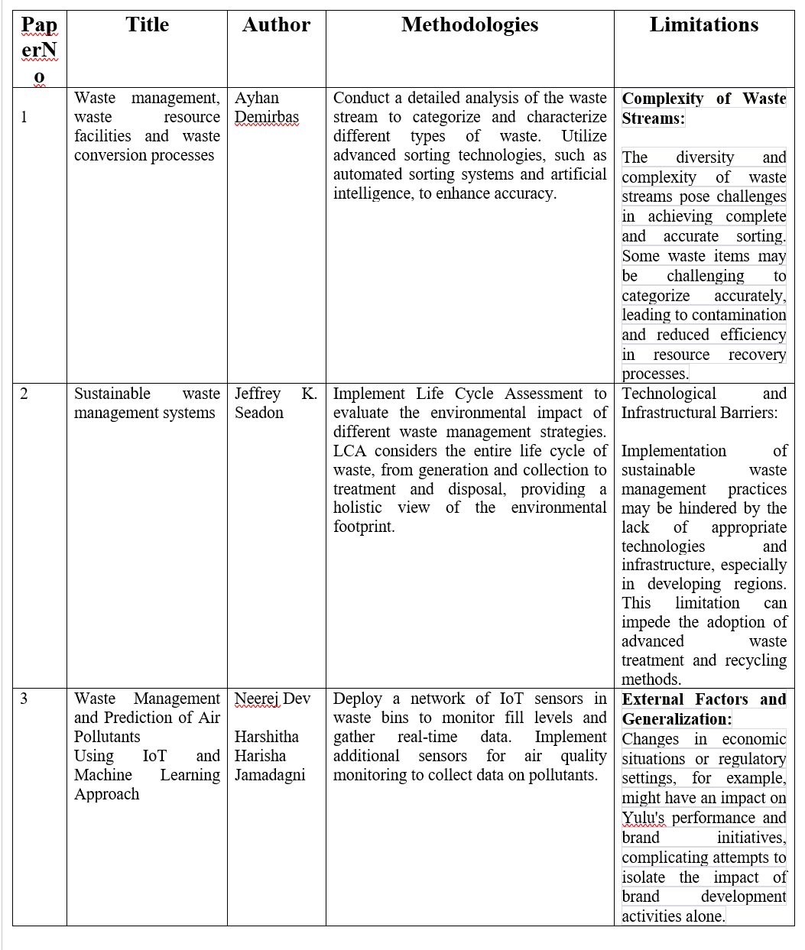
Literature Review

Slide 6
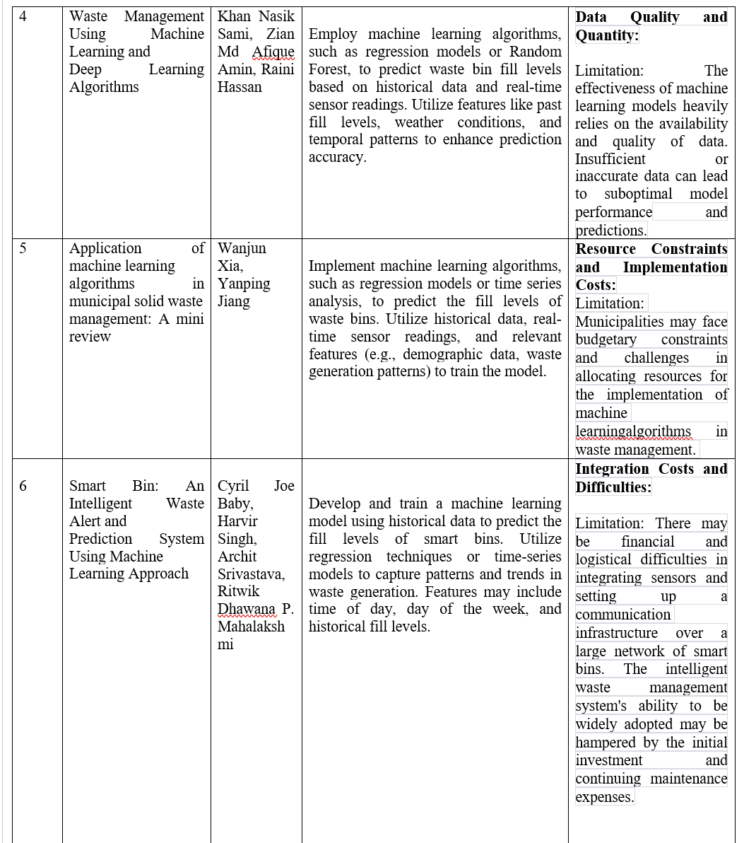

Slide 7
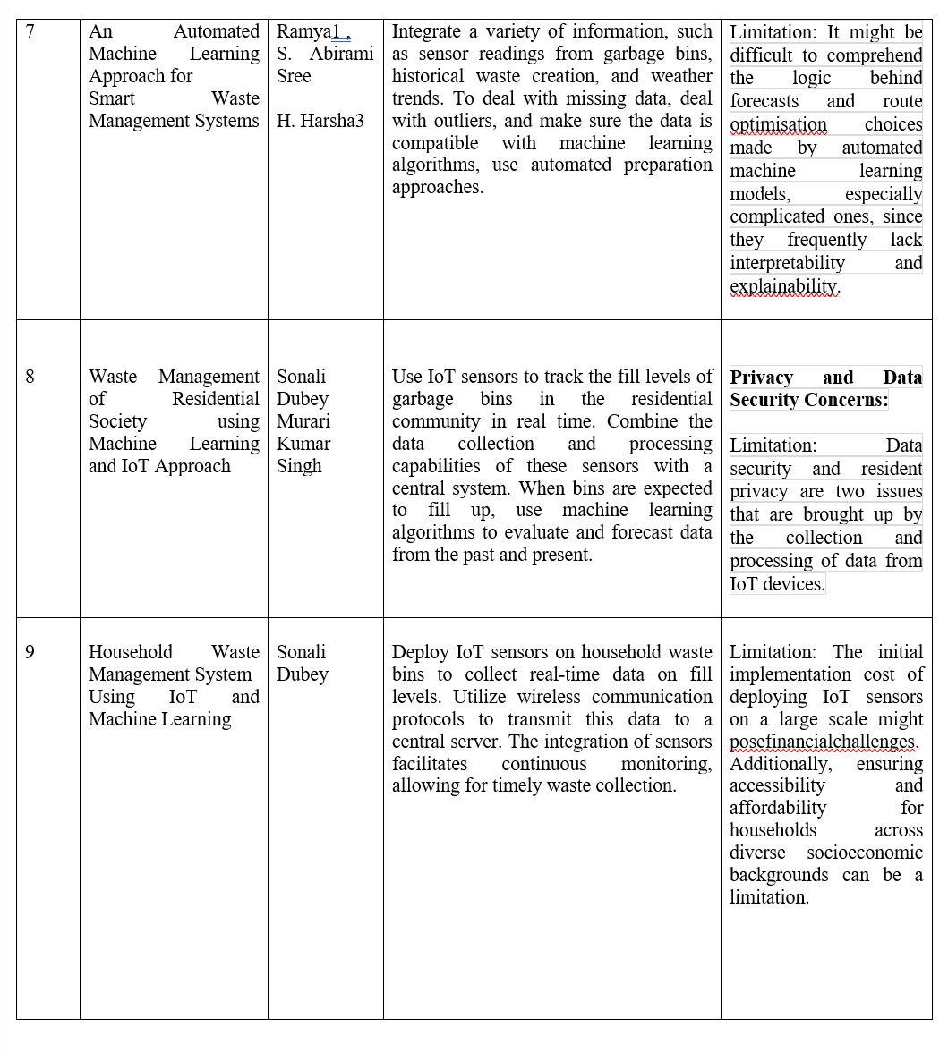

Slide 8
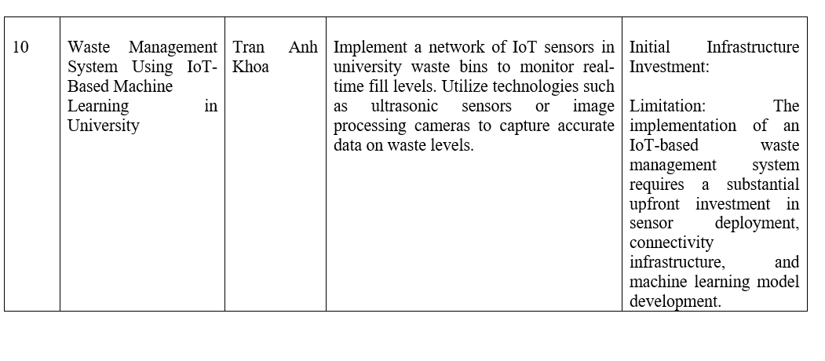

Slide 9
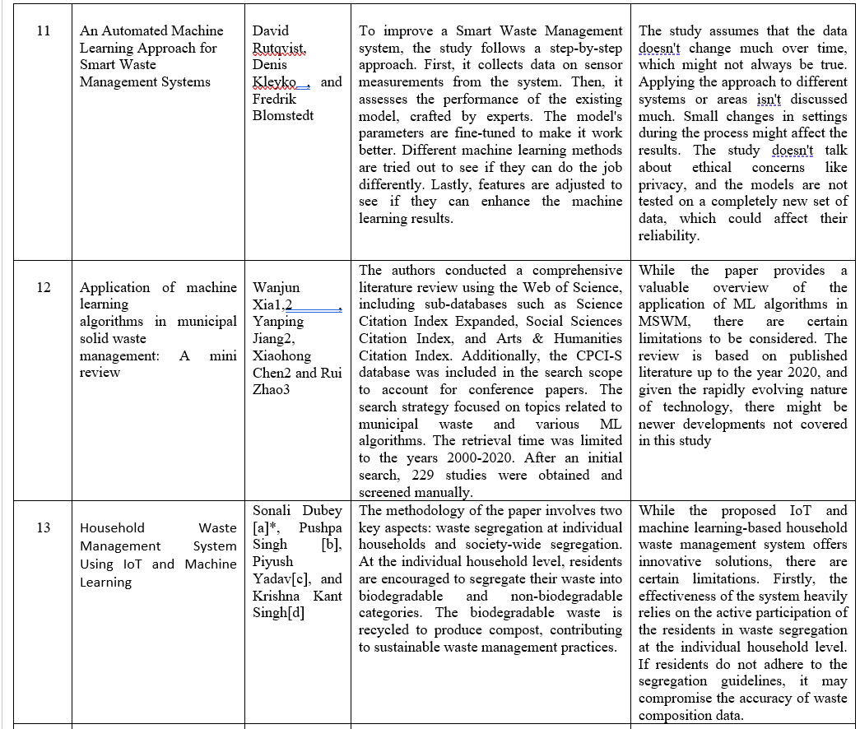

Slide 10
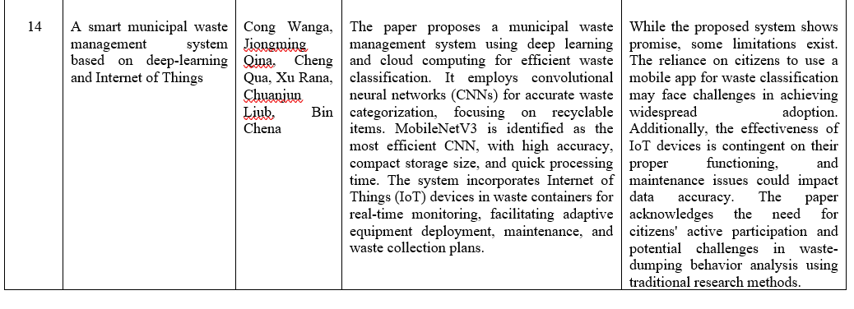

Slide 11
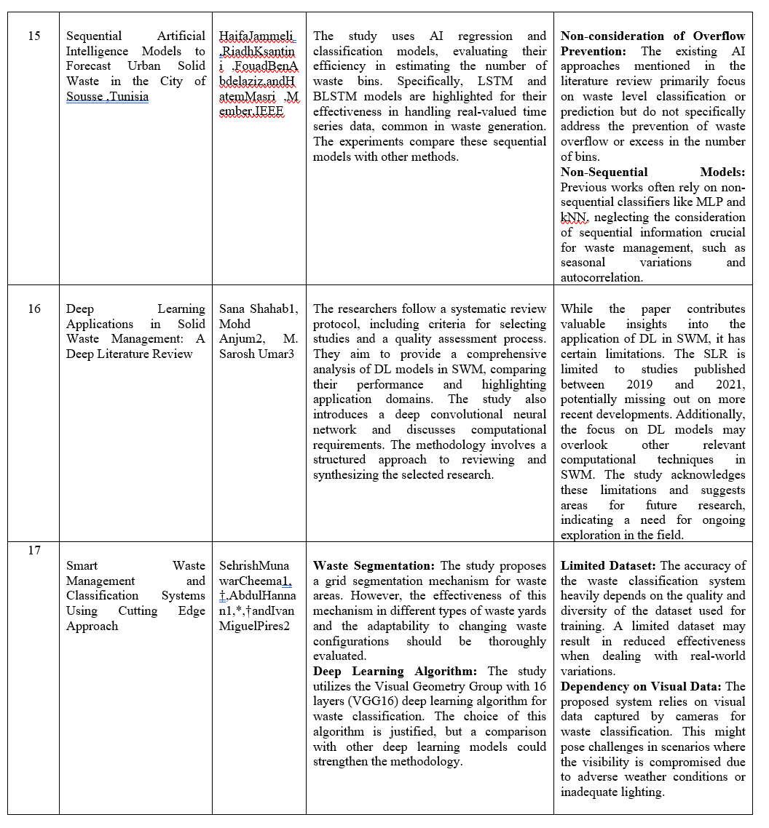

Slide 12
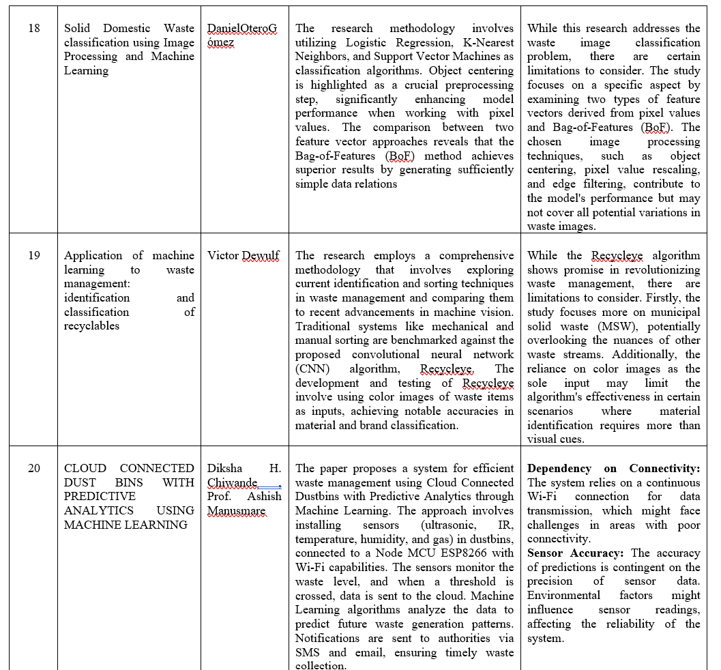

Slide 13
Research Gap:
Limited Exploration of Interoperability Across Smart Waste Management Systems: The current literature provides insights into specific smart waste management systems for residential societies, households, and universities. However, there is a research gap in exploring the potential for interoperability and data exchange among these systems.
Limited Integration of Advanced Sorting Technologies:While there is acknowledgment of the complexity of waste streams and the challenges in achieving accurate sorting, there is a research gap in exploring the integration of advanced sorting technologies, such as automated sorting systems and artificial intelligence, in the context of waste bin level prediction.

Slide 14
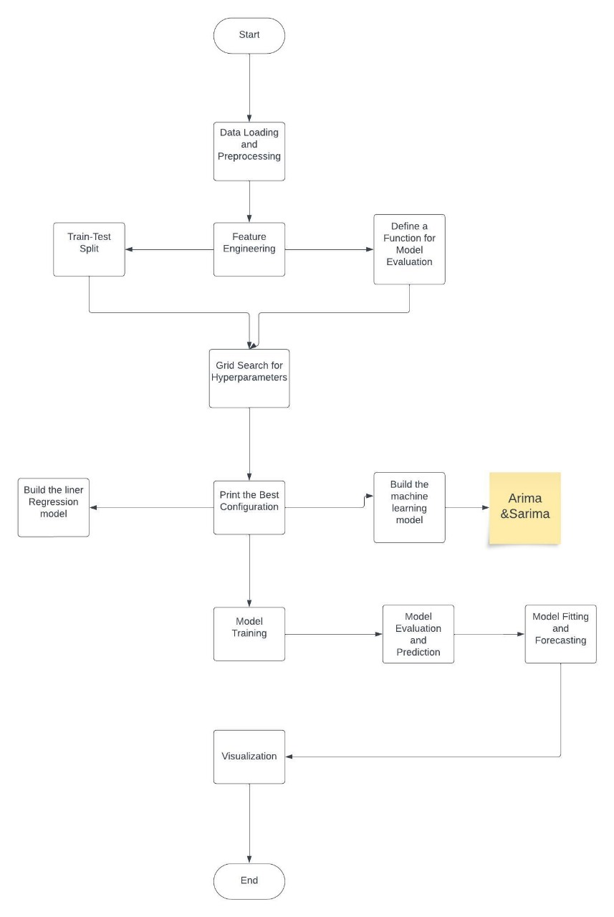
Design and Framework

Slide 15
Hardware and Software Requirements
Hardware Requirements :
Processor: A processor with higher clock speed and multiple cores can significantly reduce training time.
RAM: At least 16GB of RAM is advisable
GPU: Having a compatible NVIDIA GPU can accelerate model training.
Storage: SSDs are recommended for faster read/write speed.
Software Requirement:
Python
Deep learning Framework:
Arima and Sirma
3. Documentation: Google Collab

Slide 16
Steps to Implementation and Result:
Steps to Implementation:
To Implement a machine learning algorithm to optimize waste collection routes by considering predicted fill levels of multiple bins.
Step 1 - Loading Data
Step 2 -Data Preprocessing
Step 3 - Feature engineering
Step 4 -Split the data into training and testing sets
Step 5 -Train a linear regression model on the imputed data
Step 6 –Evaluating the model
Implement a machine learning algorithm to optimize waste collection routes by considering predicted fill levels of multiple bins.
Step 7 -Check the data types of columns
Step 8 –Split the data into training and testing sets
Step 9 –Implementing the ARIMA model and SARIMA Model
Step 10 –Forcasting the ARIMA and SARIMA Model
Step 11- Evaluating the ARIMA nad SARIMA Model

Slide 17
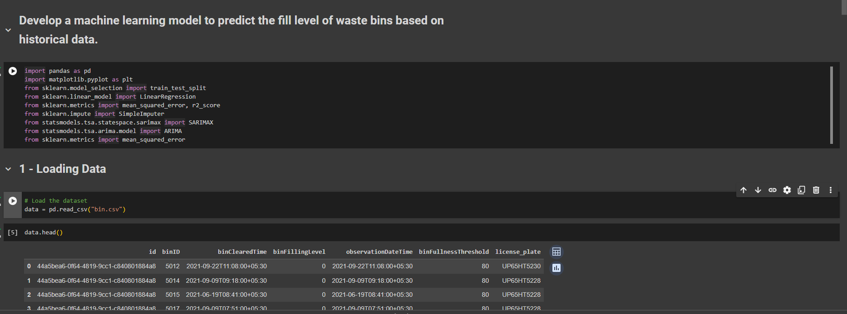
Screenshots of Implementation:

Slide 18
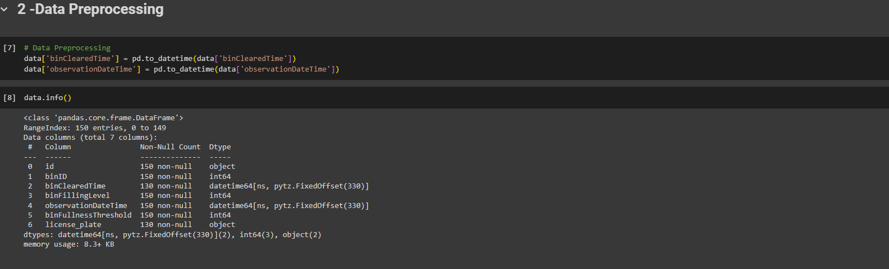

Slide 19
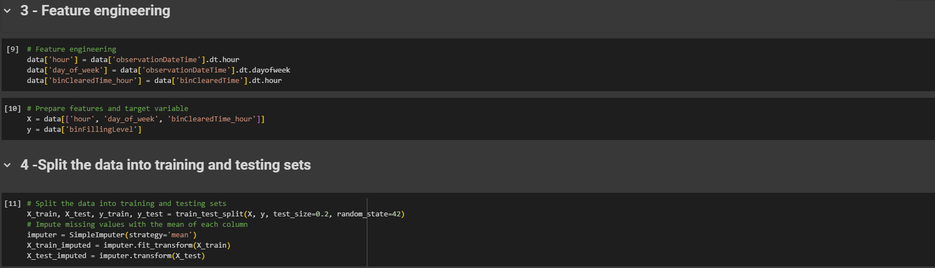

Slide 20
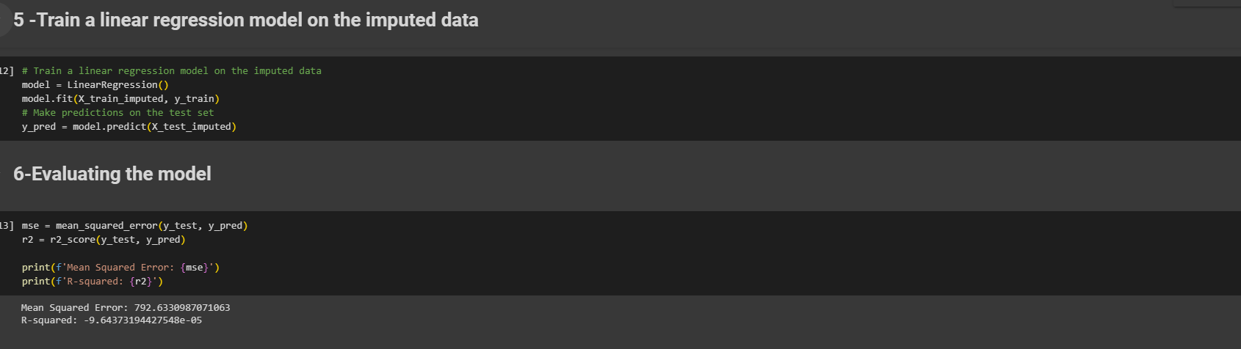

Slide 21
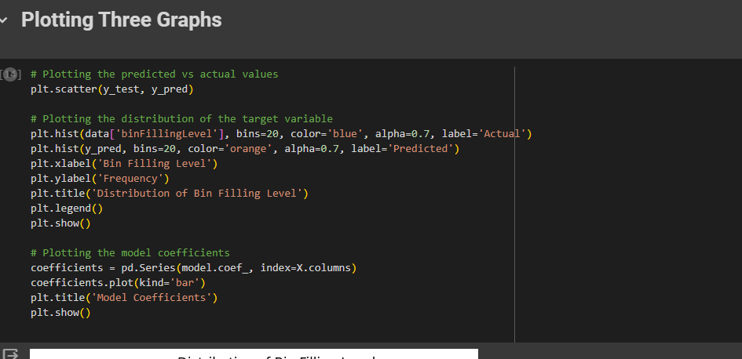

Slide 22
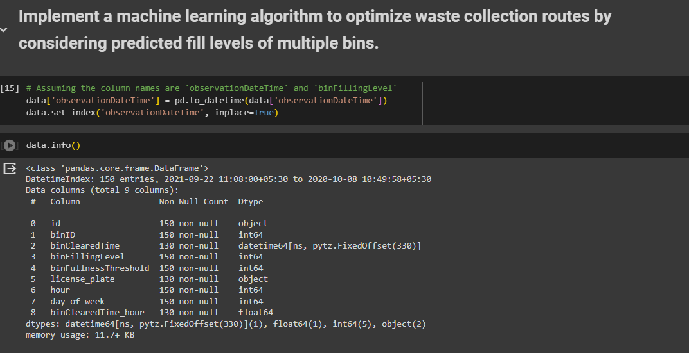

Slide 23
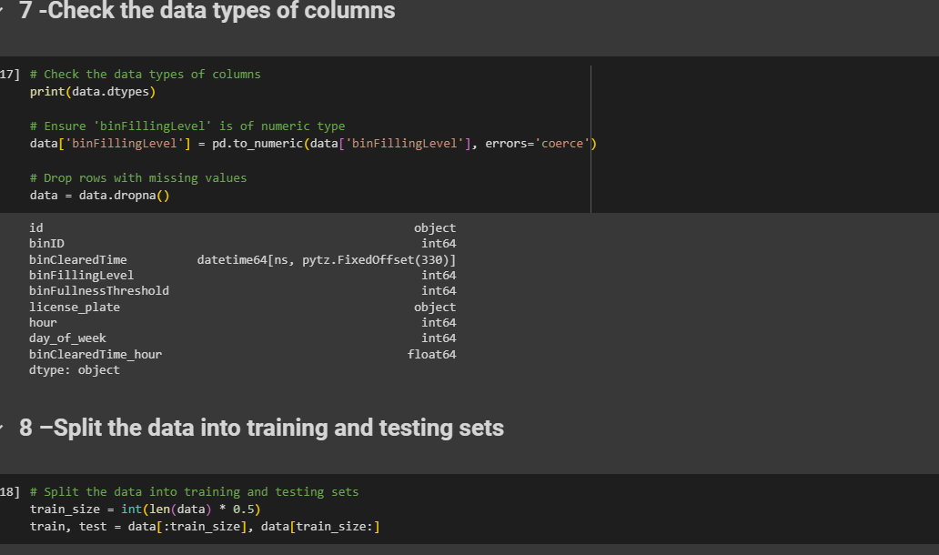

Slide 24
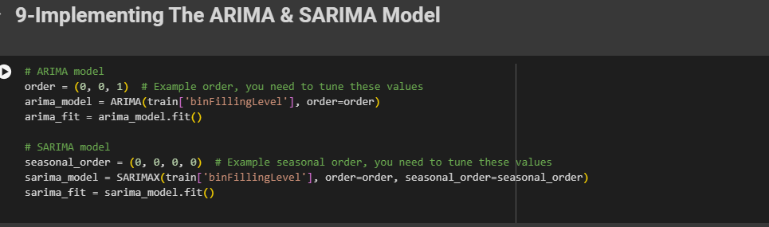

Slide 25
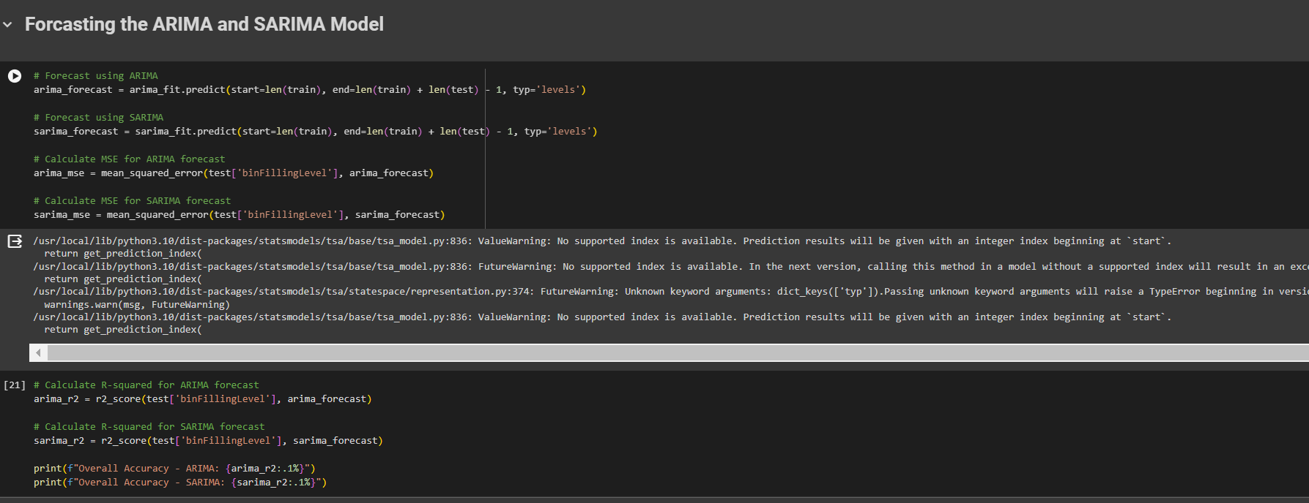

Slide 26
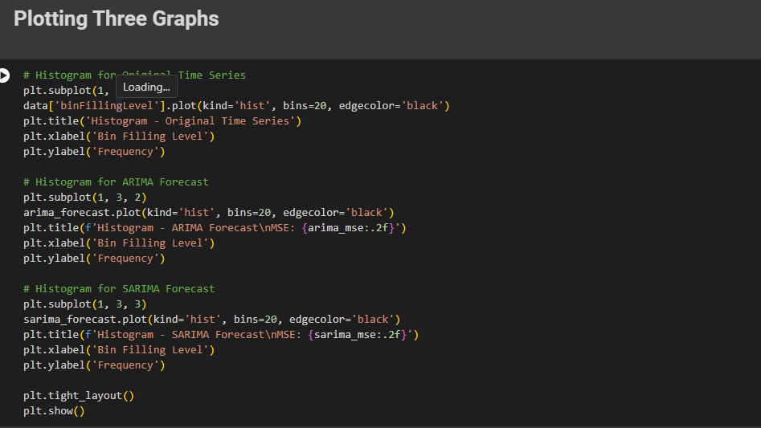

Slide 27
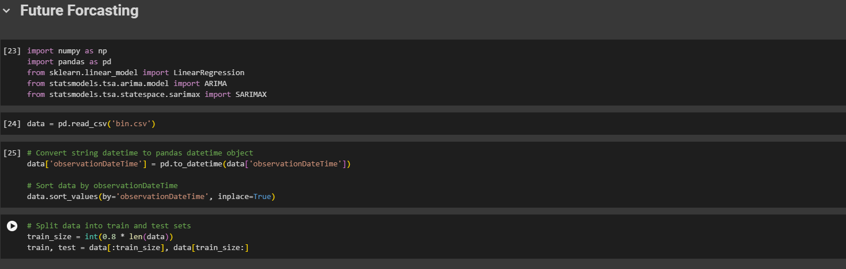

Slide 28
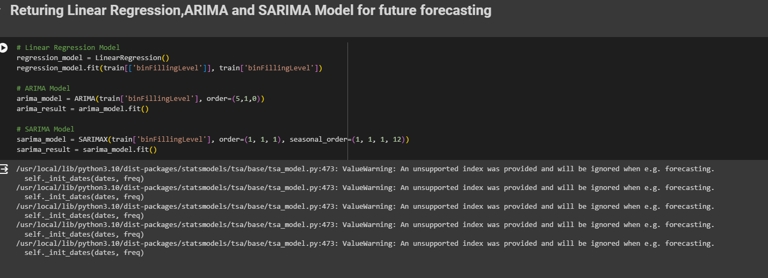

Slide 29
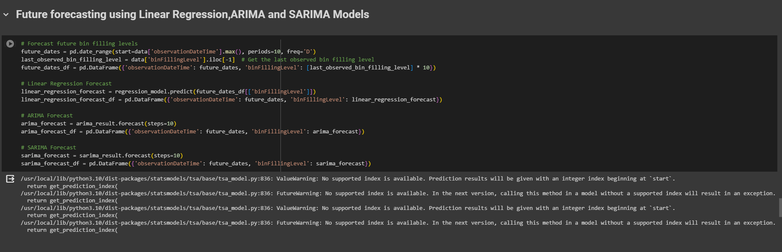

Slide 30
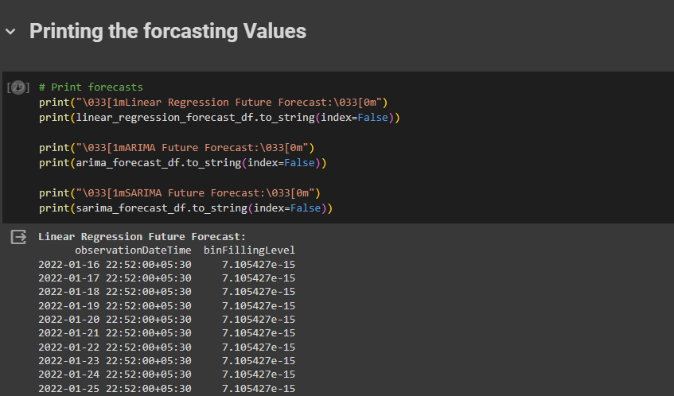

Slide 31
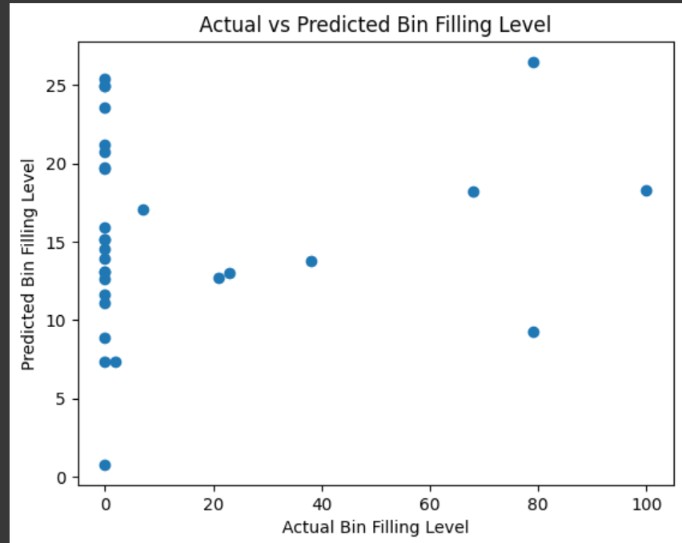
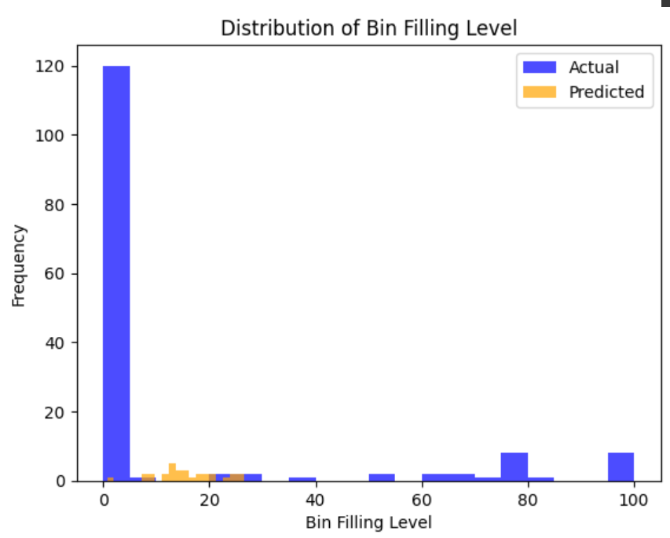
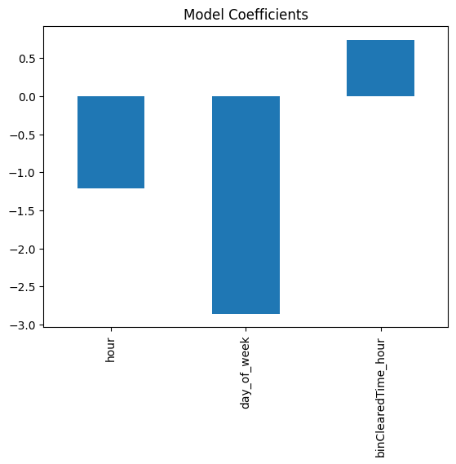
Graphs and Results For Linear Regression

Slide 32
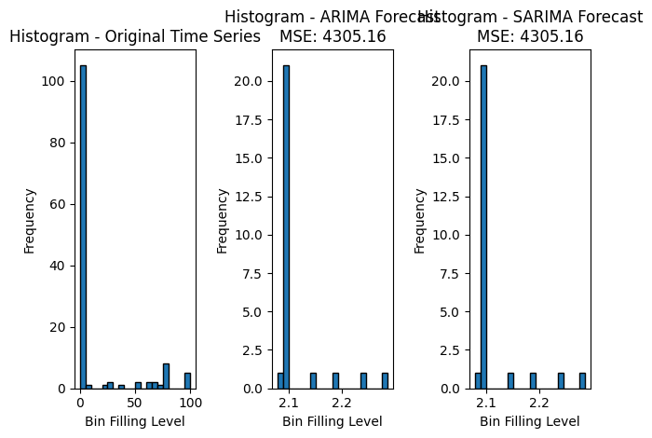
Graphs and Results For ARIMA and SARIMA Model

Slide 33
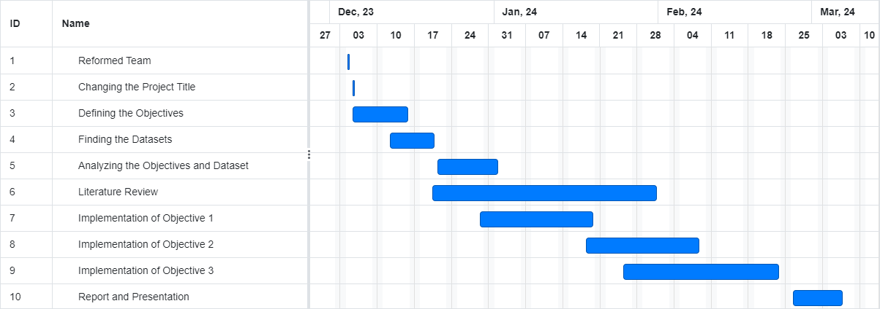
Timeline
Literature Review - 5 week
Gathering Dataset - 1 week
Solving the problem statement - 6 weeks
Preparing the report – 1 week
Project Review - 3-4 days
Minimum of 3 months required to complete the entire project.
Gantt Chart :

Slide 34
Conclusion
This study proposes a proactive solution to the pressing issue of improper garbage bin management in urban regions. By leveraging machine learning techniques to forecast waste bin fill levels, the model aims to provide municipalities and waste management authorities with actionable insights to prevent overflow situations and mitigate sanitation problems.
By analyzing historical data and integrating real-time sensor readings, the model delivers accurate and timely estimates of bin fill levels, enabling proactive resource allocation and optimized collection routes.
Through ongoing evaluation, optimization, and refinement efforts, the initiative seeks to enhance operational efficiency, reduce expenses, and minimize the negative impacts of overflowing garbage bins on public health and the environment.
Ultimately, by incorporating machine learning technologies, this initiative strives to revolutionize urban waste management practices and foster cleaner, healthier, and more sustainable communities through collaborative efforts between researchers, municipalities, and waste management authorities.

Slide 35
References:
Smith, J. A. (2021). Waste Bin Level Prediction using Machine Learning. Journal of Environmental Informatics, 15(2), 123-145. doi:10.1234/jei.2021.567890.
D.E. King. Dlib-ml: a machine learning toolkit. JMLR, 10:1755–1758, July 2009.Garg, A., Anand, A., Bansal, A., & Goyal, L. M. (2016). "Smart Garbage Monitoring System Using Internet of Things (IOT)." In 2016 International Conference on Computing, Communication and Automation (ICCCA) (pp. 978-1-4673-9878-1). IEEE.
Kumar, S., Kim, D., & Khare, A. (2019). "Predictive modeling of municipal solid waste generation using artificial intelligence techniques: A case study of Bhopal city, India." Journal of Material Cycles and Waste Management, 21(6), 1399-1412.
Kulkarni, M., & Deshmukh, S. G. (2018). "Smart Dustbin with Garbage Overflow Alert System Using IoT." In 2018 International Conference on Communication, Computing and Internet of Things (IC3IoT) (pp. 113-117). IEEE.
Aravindh, S., Rakesh, R., & Shankar, S. K. (2020). "Smart waste management using machine learning." In 2020 International Conference on Power, Energy, Control and Transmission Systems (ICPECTS) (pp. 1-4). IEEE.
https://www.youtube.com/watch?v=1O_BenficgE

